Slide 1
Introduction to Information Systems and Programming
Static Typing
ArrayList, LinkedList
Iterating

Slide 2
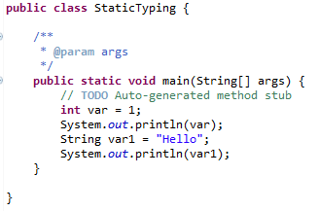
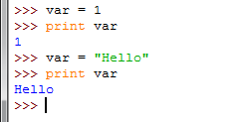
Static Typing
Java vs. Python: Java requires declaration of the variables, specifying the types of variables
The variable type stipulates: (i) the set of values that can be taken and (ii) the operations that can be performed on those values
Java is a statically-typed language
Java
Python
No declaration, variable types depend on results of assignments / program execution

Slide 3
Python is not statically-typed
No declaration, variable types depend on results of assignments / program execution
Sometimes impossible to resolve the variable type before program execution

Slide 4
Python is not statically-typed
No declaration, variable types depend on results of assignments / program execution
Sometimes impossible to resolve the variable type before program execution
var1 =1
userInput = int(input("enter a number: "))
if userInput > 1:
var2 = "hello"
else:
var2 = 10
var3 = var1 + var2
print var3

Slide 5
Static Typing
Java is a statically-typed language
The types of all variables are known at compile time
Can perform type checking statically (checking before the program even runs)
In dynamically-typed languages like Python, this type checking is deferred until execution time (while the program is running)
Many ideas in this course / modern programming language is to eliminate bugs from the code, and static typing is one idea
int e1 = 24;
String e2 = "hello";
e2 = e1;
/* found before program execution */
Program in high-level programming language
Machine code / Bytecode
compile
execute
Result

Slide 6
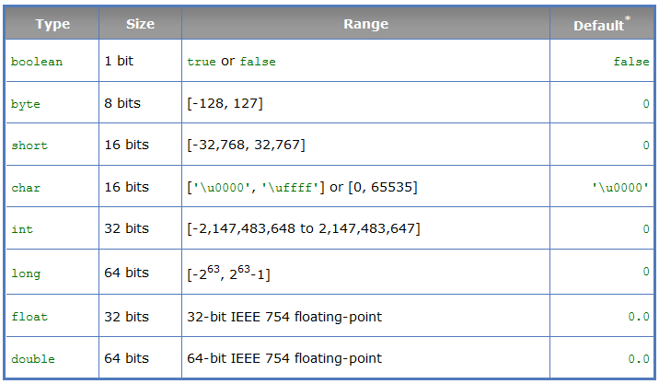
Primitive Types
int number = 0; vs int[] number = {1,2,3};

Slide 7
ArrayList, LinkedList
Array: once the array is created, its size is fixed
Example: int [] a = new int [10];
ArrayList / LinkedList: can be used to store unlimited number of objects

Slide 8
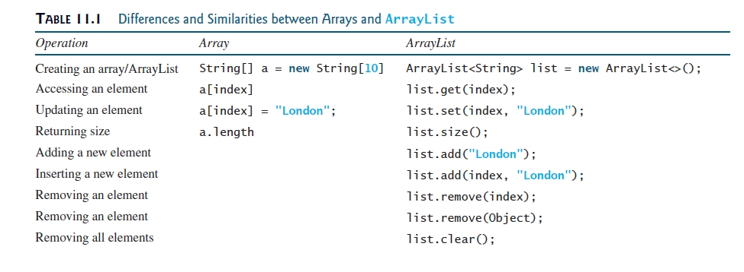
ArrayList, LinkedList

Slide 9
ArrayList, LinkedList
Operations for ArrayList and LinkedList are similar (both implemented the List interface)
Underlying mechanisms are different:
ArrayList stores elements in an array; if the capacity is exceeded, a larger new array will be created and all the elements are copied to the new array
LinkedList stores elements in a linked list data structure
Have different performance for various operations, e.g. ArrayList is more efficient to support random access through an index

Slide 10
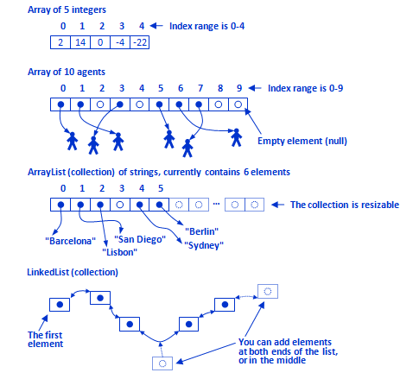
Array, ArrayList, LinkedList

Slide 11
Performance: Random Access
public class PerformanceCheck { public static void main(String[] args) { Integer[] a = new Integer[50000]; List<Integer> w = new LinkedList<>(Arrays.asList(a)); long started = System.nanoTime(); int totalCnt = 100000; for (int k=0; k< totalCnt; k++) { w.get(25000); } long time = System.nanoTime(); long timeTaken = time - started; System.out.println("time taken:" + timeTaken/1000000.0 + "ms"); } }

Slide 12
Performance: Random Access
ArrayList: 3.3ms
LinkedList: 4269ms

Slide 13
Performance: Insertion
public class PerformanceCheck { public static void main(String[] args) { Integer[] a = new Integer[50000]; List<Integer> w = new ArrayList<>(Arrays.asList(a)); long started = System.nanoTime(); int totalCnt = 100000; for (int k=0; k<totalCnt; k++){ w.add(5,2000); // insertion } long time = System.nanoTime(); long timeTaken = time - started; System.out.println("time taken:" + timeTaken/1000000.0 + "ms"); } }

Slide 14
Performance: Insertion
ArrayList: 1859ms
LinkedList: 13.33ms

Slide 15
Generics
Generics is a programming language design to use type as parameter
ArrayList<String> w1 = new ArrayList<String>();
ArrayList<Integer> w2 = new ArrayList<Integer>();
ArrayList<String> w3 = new ArrayList<>();

Slide 16
Generics
Detect error at compile time rather than runtime, i.e., static checking
More reliable
ArrayList<String> l = new ArrayList<String>(); l.add("hello"); l.add("bye"); l.add("haha"); l.add(2); // error detect at compile time

Slide 17


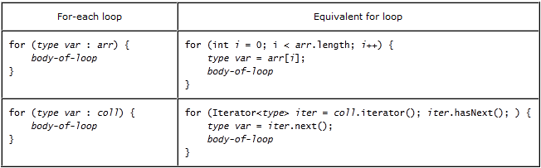
Iteration Types

Slide 18
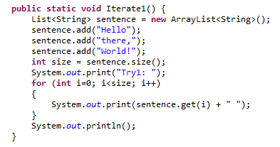
Iterating
ArrayList<String> sentence = new ArrayList<String>();
Use index

Slide 19
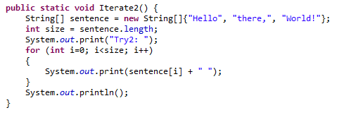
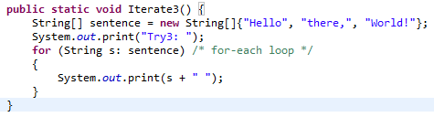
Iterating
for-each loop

Slide 20
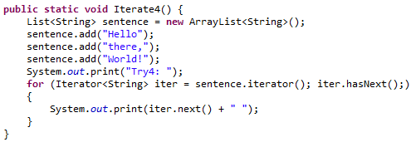
Iterating
ArrayList<String> sentence = new ArrayList<String>();
Use an iterator

Slide 21
Activity
Write a program that uses an iterator to compute the sum of all integer values in an ArrayList of integers
Write a second code segment that does the same thing but using a for-each loop

Slide 22
Summary
Static typing – Java vs Python
Static vs Dynamic typing – pros and cons
Implementing Hailstone Sequencer – Arrays and Collections
Different forms of iteration
Complete program – class structure and methods (main)
Cohort Section Activities – reinforce understanding and experience to implement basic Java applications

